Slide 1
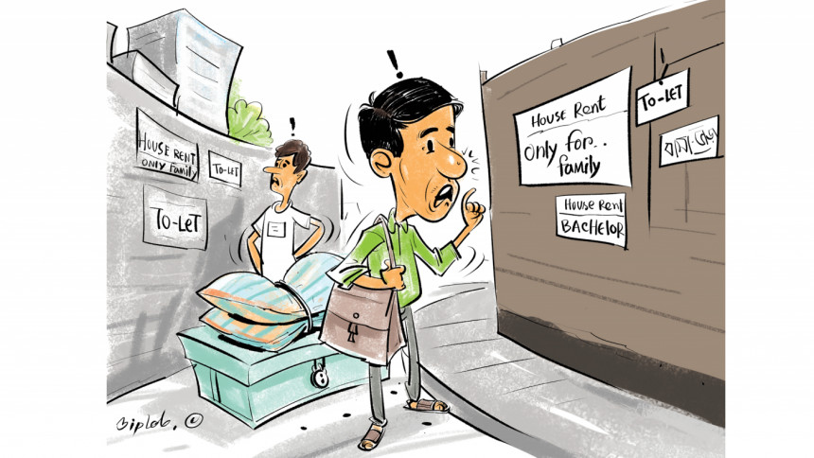

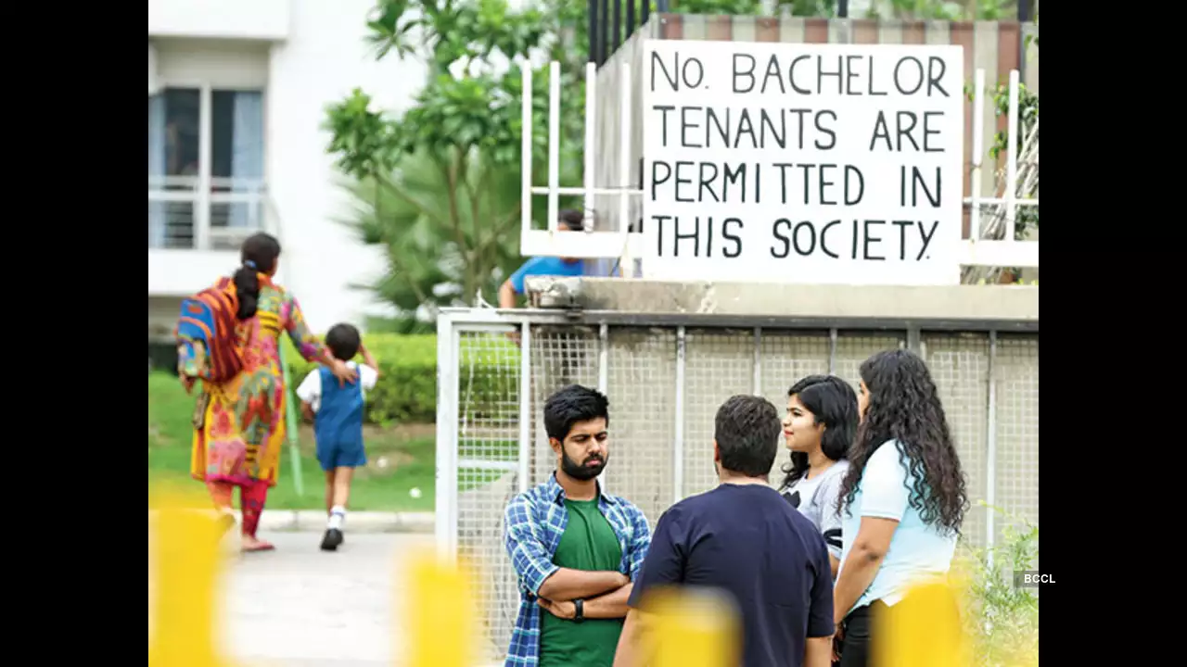
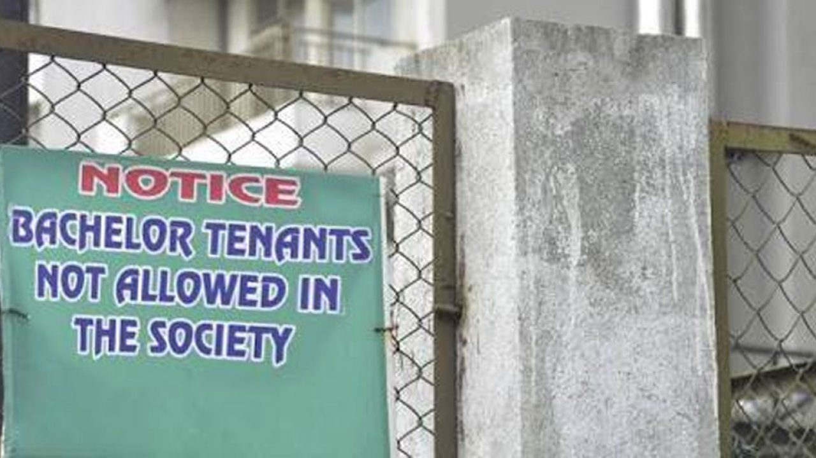
Title: A Web Platform for Solving Housing Challenges for Bachelors in Dhaka
Supervisor : KMM .
Course : CSE299
Semester : Summer 2024
Section : 1

Slide 2
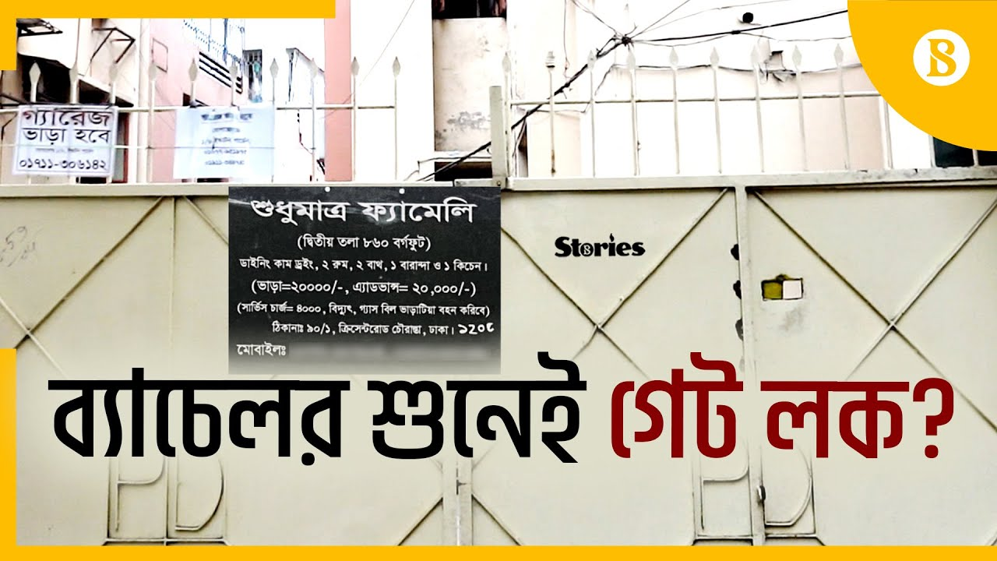

Title : Problem being solved
1
Lack of centralized platform for bachelor housing in Dhaka.
2
Discrimination by landlords against bachelors.
3
No one can rent to them unless they're married.
4
High rent, advance fees, and rigid restrictions
5
Difficulty in finding shared accommodations.
6
Time-consuming search process.

Slide 3


Title Review of Existing Platforms
1.Bpoperty.com
Feature: Largest real estate platform in Bangladesh.
Limitation: Not customized for bachelors, limited visualization options.
2. THE TOLET.COM
Feature: Online platform for various rental needs.
Limitation: Poor UI, no filtering or location selection.

Slide 4




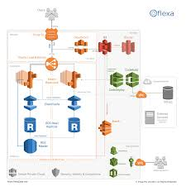
Tittle: Solutions adopted
1.User-Centric Interface: Easy navigation for both
bachelors and landlords.
2.Enhanced Search: Filter based on location, rent, services.
3.Integrated Housekeeping Services: Unique feature for
added convenience.
4.Verification System: Ensure transparency and reduce fraud.
5.Scalable Architecture: Expandable to more cities and services.

Slide 5
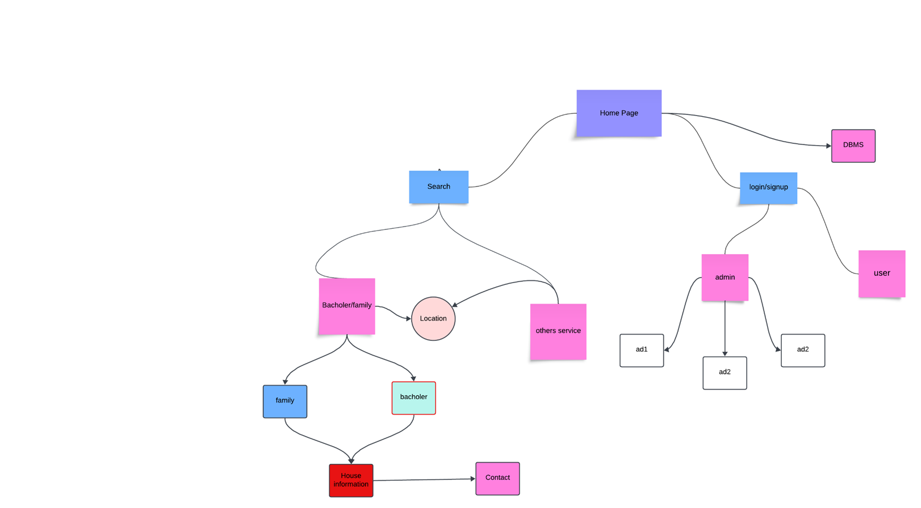
Title : System Overview :
Fig: Diagrams for the complete system

Slide 6
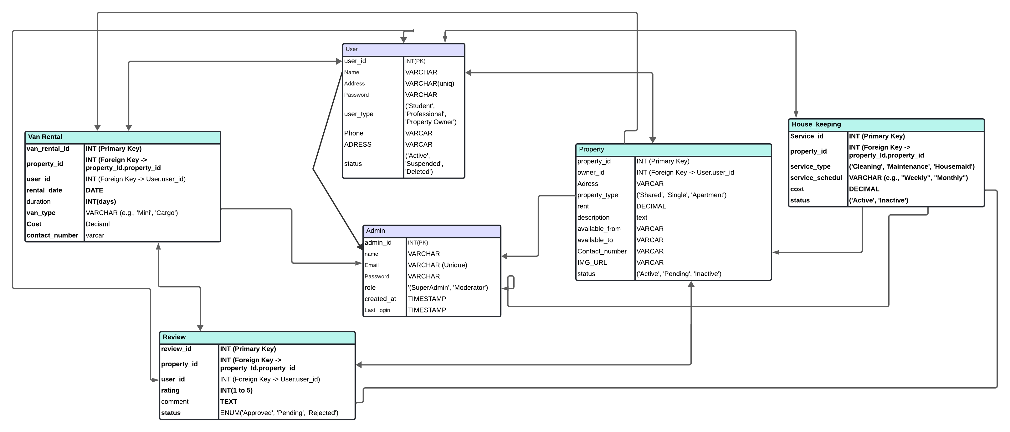
Title: Database and ERD Diagrams
Fig: ERD Diagrams

Slide 7
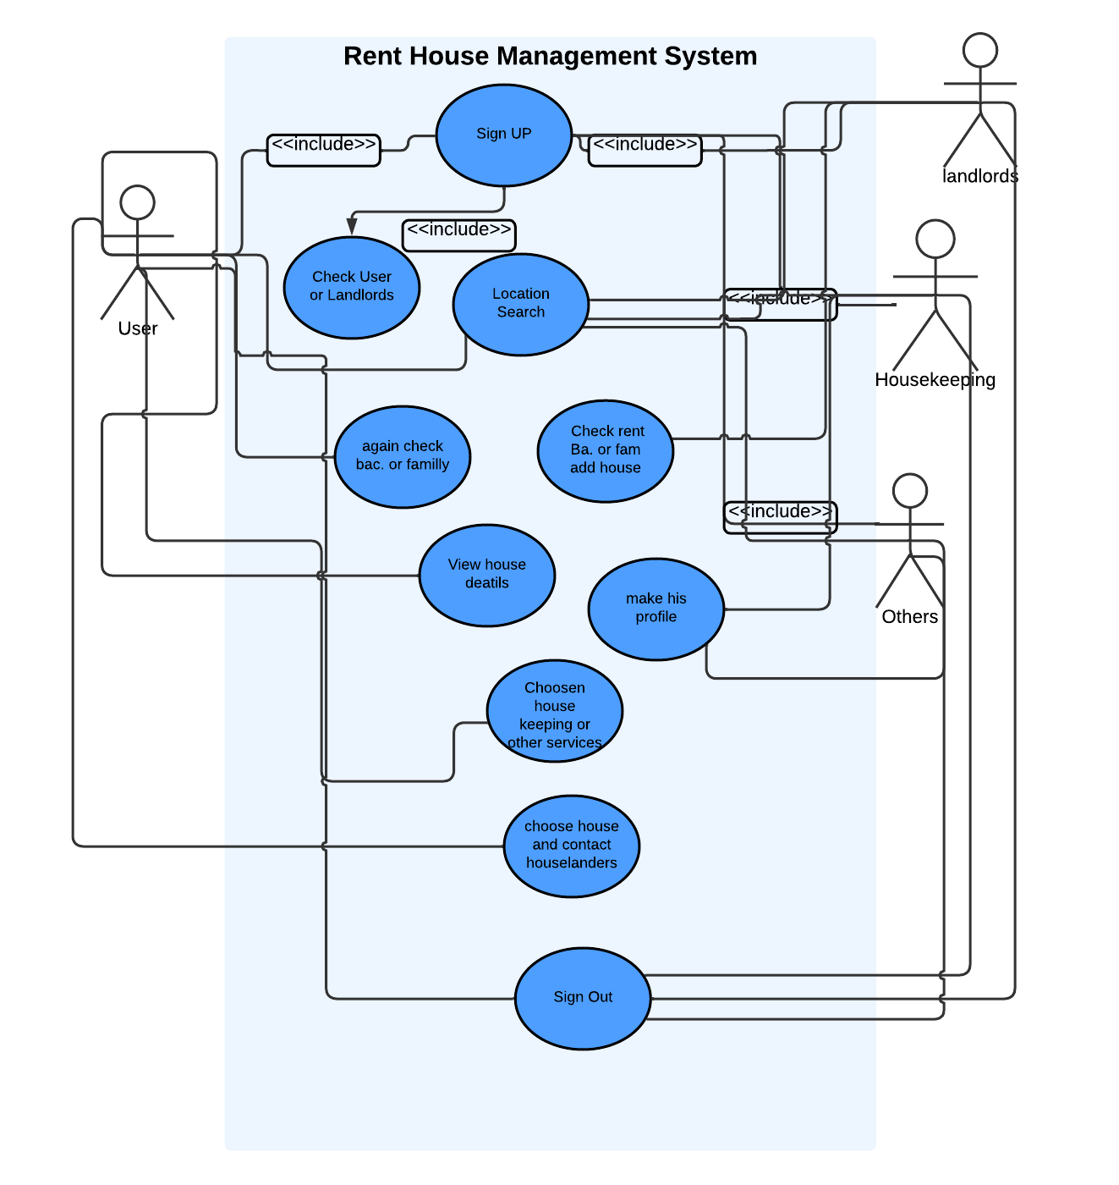
Title : Use case Diagram :

Slide 8







Title: Technology Stack
Backend:
PHP, Laravel, MySQL.
2. Frontend:
HTML5, CSS, JavaScript, ReactJS.
3. Collaboration:
GitHub for version control.
4. Others:
Stripe for payment integration, AWS for hosting.

Slide 9
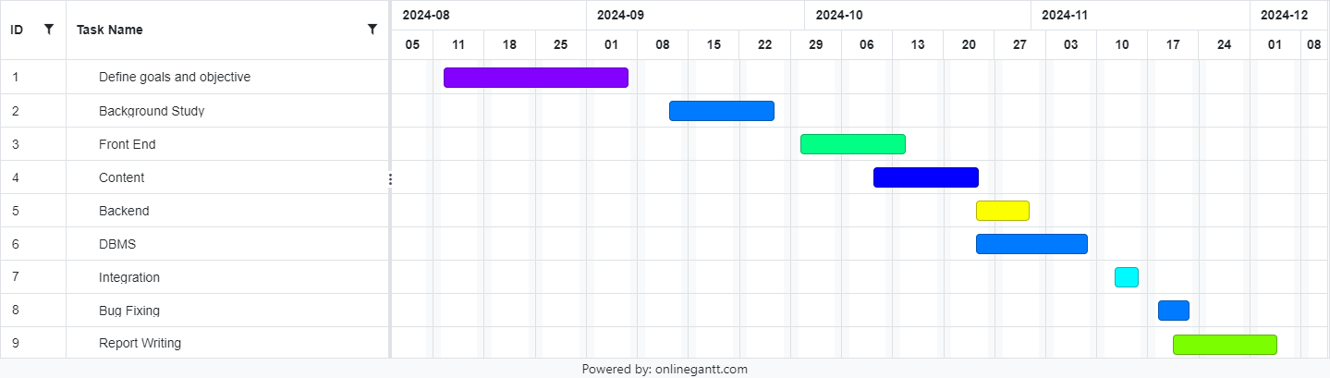
Title: Development Plan
Fig: Gantt Chart

Slide 10
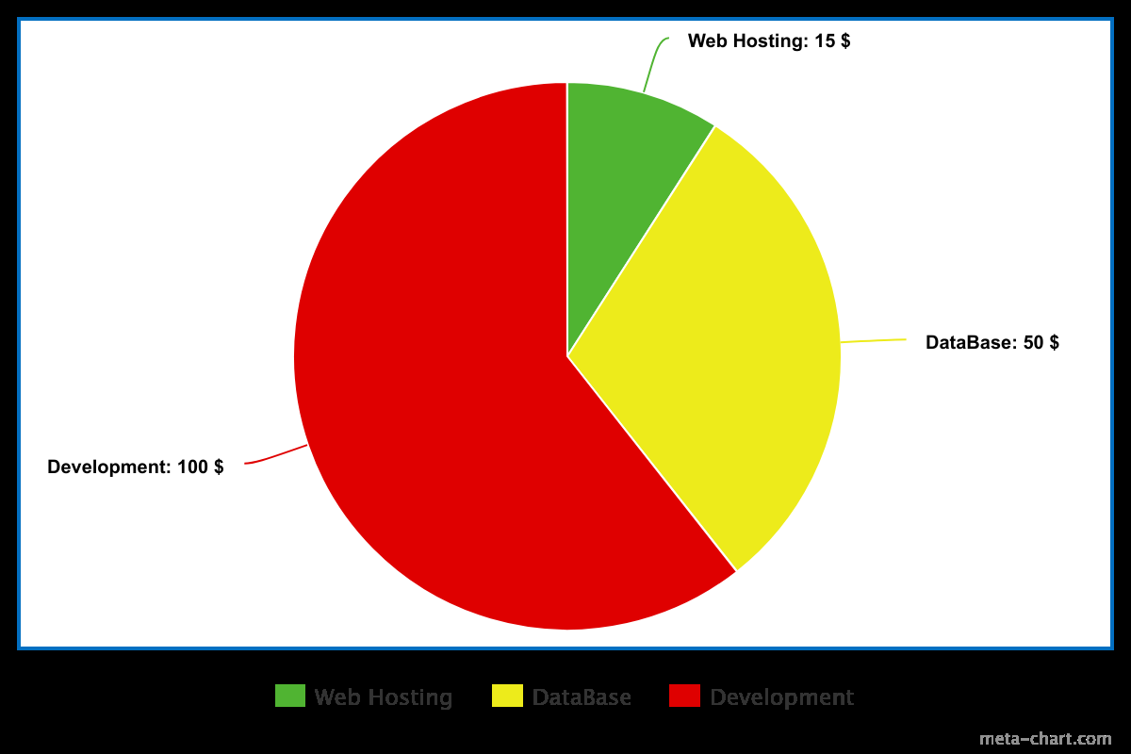
Title: Costing and Maintenance

Slide 11


Title: Our Vision
To develop a highly efficient and accessible rental platform, continuously optimized through mobile app versions, user feedback, and performance enhancements. Our goal is to empower bachelors and young professionals in Dhaka by eliminating housing discrimination, streamlining the search for quality and affordable accommodations, and fostering transparency and trust between tenants and landlords through regular updates and feature enhancements.
Project Vision Rent House for bachelor

